Slide 1
Use Case Diagram
Object Oriented Development
with Java
(CT038-3-2 and Version VC1)
System Modeling

Slide 2
Topic & Structure of The Lesson
Usecase diagram

Slide 3
Learning outcome
At the end of this lesson, you will be able to:
Model a system using a use-case diagram

Slide 4
Key terms you must be able to use
If you have mastered this topic, you should be able to use the following terms correctly in your assessments:
--Usecase –actors,usecase,extend,include

Slide 5
Use Case Diagram
Used for describing a set of user scenarios by showing the relationships between actors and use cases in a system
used for capturing user requirements
Works like a contract between the end user and software developers

Slide 6
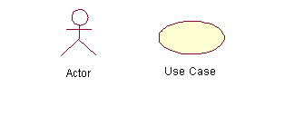
Components of a Use Case Diagram
Actors: A role that a user plays with respect to the system, including human users and other systems. e.g.,inanimate physical objects (e.g. robot); an external system that needs some information from the current system.
Use case: A set of scenarios that describe an interaction between a user and a system, including alternatives. Begin with a verb. Sequence of use case shows timing of events/operations
System boundary: rectangle diagram representing the boundary between the actors and the system.

Slide 7
Components of a Use Case Diagram (core relationship)
Association: communication between an actor and a use case and is represented by a solid line.
Generalization: relationship between one general use case and a special use case (used for defining special alternatives)
Represented by a line with a triangular arrow head toward the parent use case.

Slide 8
Components of a Use Case Diagram (core relationship)
Include: a dotted line labeled <<include>> which begins at the base use case and ends with an arrows pointing to the include use case. The include relationship occurs when a chunk of behavior is similar across more than one use case. Use “include” in stead of copying the description of that behavior.
<<include>>
Extend: a dotted line labeled <<extend>> with an arrow toward the base case. The extending use case may add behavior to the base use case. The base class declares “extension points”.
<<extend>>

Slide 9
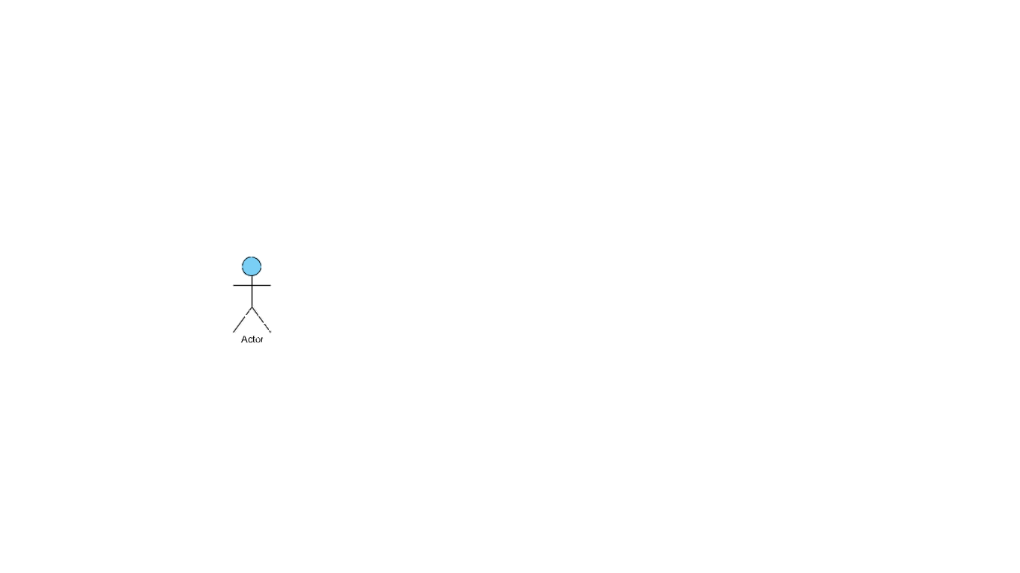
Basic Use Case Diagram Symbols and Notations
System
Use-Case / Operation
Actors
Primary Actors
Secondary Actors
Relationships
Association
Includes
Extends
System_Name
Case_1
<<Extend>>
Case_2
<<Include>>
Case_3
Notes:
Illustrate relationships between an actor and a use case with a simple line. For relationships among use cases, use arrows labeled either "uses" or "extends." A "uses" relationship indicates that one use case is needed by another in order to perform a task. An "extends" relationship indicates alternative options under a certain use case.

Slide 10
Use Case Diagram: Smart Phone
Smart Phone
Search Phone Book
<<Includes>>
Manipulate Contacts
<<Extends>>
{Option==Delete}
<<Extends>>
{Option==Edit}
<<Extends>>
{Option==Contact}
Call Contact
Modify a Contact
Contact Person
Delete Contact
Smart Phone User
Add New Contact
<<Extends>>
{Option==Message}
<<Extends>>
{Option==Call}
Place a Call
Send a Message
Receive a Call

Slide 11
Use Case Diagram: ATM
ATM Machine
Withdraw Cash
<<Extends>>
Pay Bills
Print Receipt
Customer
Transfer Funds
<<Includes>>
Restock Paper
Maintenance Man

Slide 12
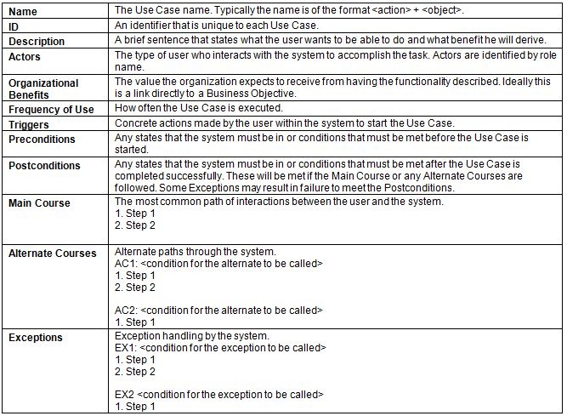
Use Case: Case Descriptions
A use case is often accompanied by use case description and actor descriptions

Slide 13
Use-Case Description For: ATM
Use Case Description: Restock Paper
Name | Restock Paper
ID | N/A
Description | Refill the ATM Machine with paper rolls to print receipt
Actor(s) | Maintenance Man
Organizational Benefits | N/A
Frequency of Use | N/A
Triggers | N/A or Maintenance Man
Precondition | ATM Machine CANNOT print receipts
Post-condition | ATM Machine CAN print receipts

Slide 14
Use-Case Description For: ATM
Use Case Description: Pay Bills
Name | Pay Bills
ID | N/A
Description | Allows the user to pay the house bills
Actor(s) | Customer
Organizational Benefits | N/A
Frequency of Use | N/A
Triggers | N/A or Customer
Precondition | N/A
Post-condition | N/A

Slide 15
Use-Case Description For: ATM
Use Case Description: Withdraw Cash
Name | Withdraw Cash
ID | N/A
Description | Allows the user to withdraw money (RM1, RM10, and RM50)
Actor(s) | Customer
Organizational Benefits | N/A
Frequency of Use | N/A
Triggers | N/A or Customer
Precondition | The ATM Machine has sufficient Money
Post-condition | The ATM Machine has less Amount of Money

Slide 16
Quick Review Questions
What is a use case diagram?
What are the components of a use case diagram?
Draw the use case diagram for borrowing a book from the library

Slide 17
Summary of Main Teaching Points
-Usecase diagrams and components

Slide 18
Q & A

Slide 19
Next Session
-class diagram

